Slide 1
Freshtech mobile application
BY MWAURA SNEASE WAMBUI
119824
DIPLOMA IN BUSINESS INFORMATION TECHNOLOGY

Slide 2
BACKGROUND
It is a food recipe app with ordering capabilities from selected retailers
Created using android studio which has a built in AVD and SDK. The device API used to run the app was……
For the database DB browser for SQLite was used to create, design and edit database and Java programming language was used.
Four modules were designed for the app ; admin, retailer, user and dietitian
User was supposed to sign up, log in, browser cart, select item, submit item to check out and the system initiates a payment method (yet to be decided)to generate an order receipt.
Admin was supposed to log in, can add or remove other users in all other modules and edit the database
Dietitian was supposed to sign up, log in, upload recipes to app repository and provide feedback to users
Retailer was supposed to sign up, log in, receive order requests, receive payment, initiate tracking of the delivery.
Logging out is implemented in all modules.

Slide 3
PROBLEM STATEMENT
This application is aimed at solving the SDG of good health and wellbeing by improving accessibility to healthier alternatives of nutrition through a meal plan subscription service. Freshtech aims at solving the problem of maintaining proper nutrition and dieting on a daily basis. These problems were caused by either lack of time, adequate finances and adequate knowledge.

Slide 4
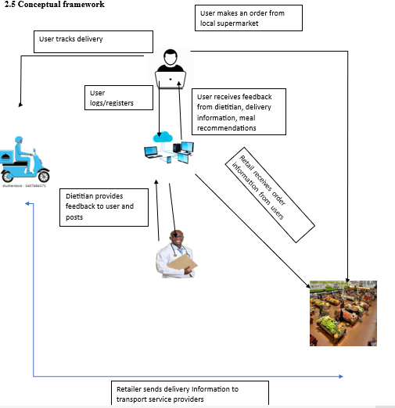
Conceptual Framework

Slide 5
System structure
The two modules were completed ; user and admin module
The user module whereby ; the user can register, log in, browse the carts , add items into the cart, submit the cart for check out .
The user can browse externally for new recipes using an external hyperlink directing the app to supercook.com
The admin module one can ; log in, delete user,
Dietitian and retail module are yet to be implemented. System is not yet able to initiate payment request and generate order receipt.

Slide 6
CONCLUSIONS AND recommendations
Additional system functionalities will be added such as tracking feature which will enable customers to keep track on their deliveries. The system can also be improved by adding strong authentication processes such as checking password lengths, two-factors authentication to heavily protect all user’s (customer, dietitian and retailer) data and the application’s data.
For the mobile application to run smoothly, a compatible Android device that runs Android 5.0 (API level 21) or higher and has the Google Play Store app installed is needed. The Android emulator with an AVD that runs the Google APIs platform based on Android 5.0 (API level 21) or higher. Also requires access to internet for the browsing fragment.

Slide 7
Thank you
ANY QUESTIONS, IF NONE HAPPY HOLIDAYS

